Slide 1
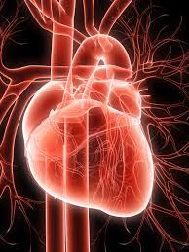
Cardiac Contraction and Relaxation
Dr.Divya E M

Slide 2
Introduction
The heart is actually two separate pumps:
right heart
that pumps blood through the lungs
left heart
that pumps blood through the peripheral organs

Slide 3
In turn each of these hearts is a pulsatile two-chamber pump
Composed of an atrium and a ventricle
Each atrium is a weak primer pump for the ventricle helping to move blood into the ventricle
The ventricles then supply the main pumping force that propels the blood
(1) through the pulmonary circulation by the right ventricle
(2) through the peripheral circulation by the left ventricle

Slide 4
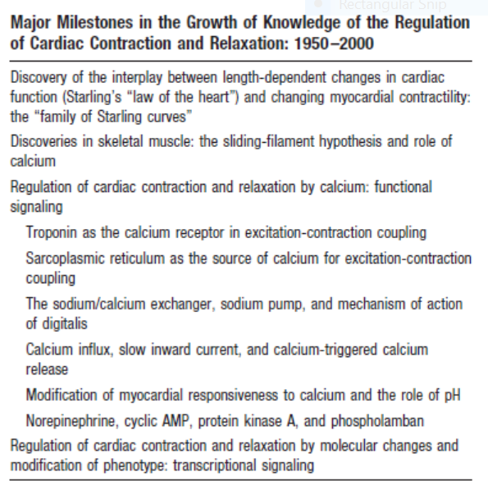

Slide 5
Physiology of Cardiac Muscle
The heart is composed of three major types of cardiac muscle:
Atrial muscle, ventricular muscle, and specialized excitatory and conductive muscle fibers
The atrial and ventricular types of muscle contract in much the same way as skeletal muscle except that the duration of contraction is much longer

Slide 6
Specialized excitatory and conductive fibers
Contain few contractile fibrils
Exhibit either automatic rhythmical electrical discharge in the form of action potentials or conduction of the action potentials through the heart
Notes:
Hence contract only feebly

Slide 7
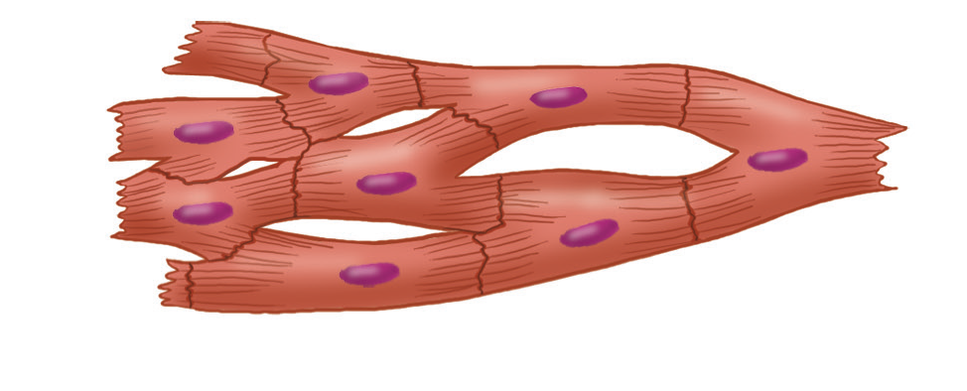
CARDIAC MYOCYTE
cardiac muscle fibers are arranged in a latticework, with the fibers dividing recombining and then spreading again
Notes:
The dark areas crossing the cardiac myocytes are called intercalated discs.they are actually cell membranes that separate individual cardiac muscle cells from one anotherAt each intercalated disc the cell membranes fuse with one another to form permeable “communicating” junctions (gap junctions) that allow almost totally free diffusion of ions
Therefore action potentials travel easily from one cardiac muscle cell to the next

Slide 9
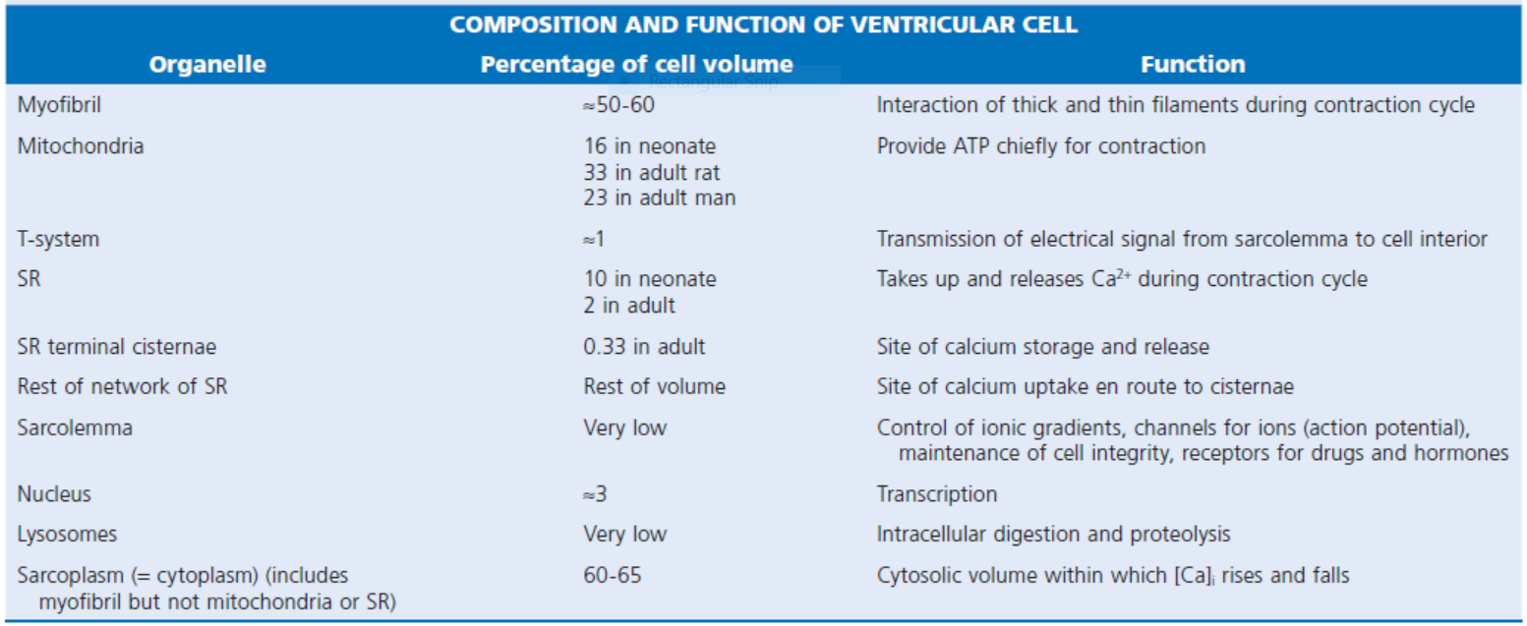

Slide 10
MICROANATOMY OF CONTRACTILE CELLS AND PROTEINS
The major function of cardiac muscle cells (cardiomyocytes or myocytes)is to execute the cardiac contraction-relaxation cycle
The contractile proteins of the heart lie within these myocytes
A group of myocytes held together by surrounding collagen connective tissue is a myofiber

Slide 11
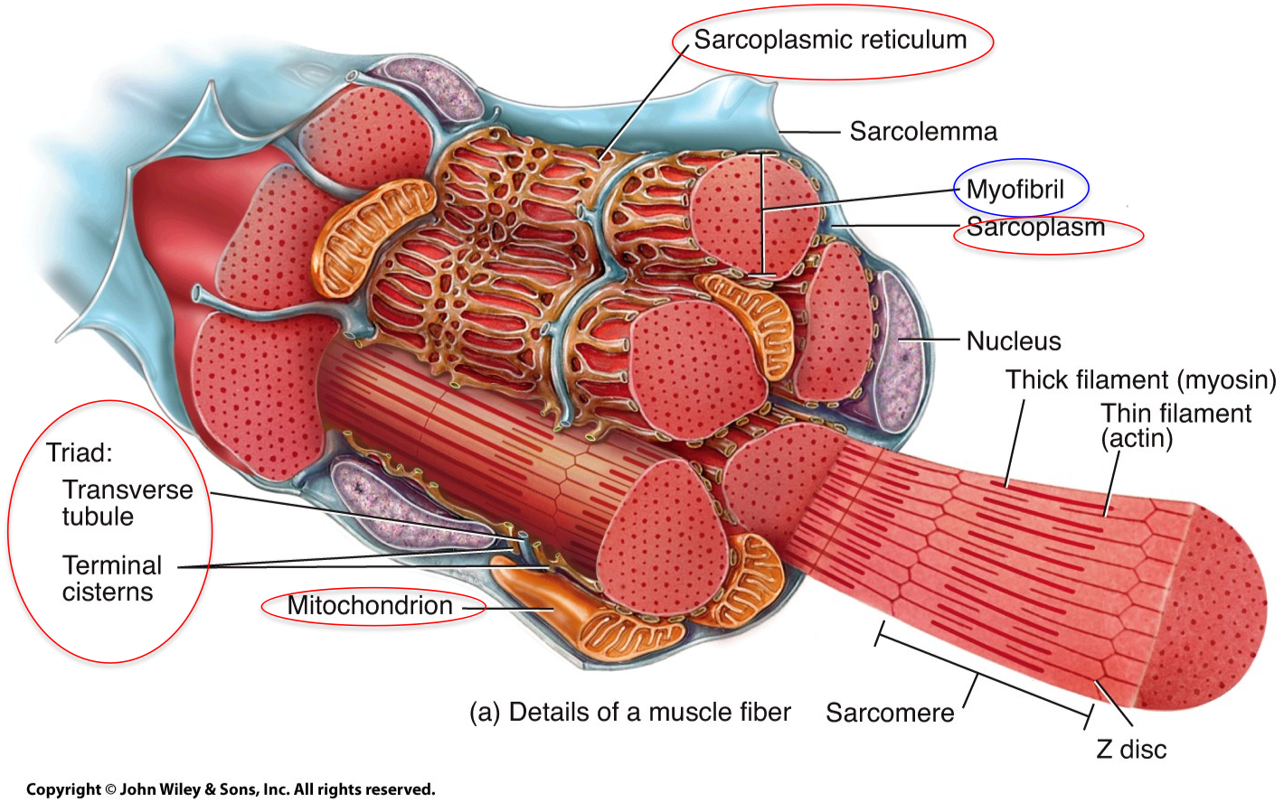

Slide 12
Notes:
Each myocyte is bounded by a complex cell membrane the sarcolemma and is filled with rodlike bundles of myofibrils which are the contractile elements. The myocyte sarcolemma invaginates to form an extensive tubular network (the T tubules) that extends the extracellular space into the interior of the cell. Rows of mitochondria are located between the myofibrils and also immediately beneath the sarcolemma. Mitochondria function mainly to generate the energy in the form of adenosine triphosphate (ATP) needed to maintain the heart’s contractile function and the associated ion gradients

Slide 13
Sarcolemma
The sarcolemma is composed of a lipid bilayer
The sarcolemma forms 2 specialized regions of the myocyte the intercalated disks and the transverse tubular system
The intercalated disks are a specialized cellcell junction which serves both as a strong mechanical linkage between myocytes and as a path of low resistance that allows for rapid conduction of the action potential between myocytes

Slide 14
Sarcoplasmic reticulum
An intracellular membrane network is a highly efficient Ca2+ handling organelle specialized for the regulation of cytosolic Ca2+ concentration
Contains three important components that participate Ca2+ homeostasis:
Sarcoplasmic reticulum Ca2+ATPase (SERCA-2)
Regulatory protein of SERCA-2 phospholamban
Ca2+ release channel

Slide 15
Sarcoplasmic reticulum
Notes:
The sarcoplasmic reticulum (SR) is a specialized form of endoplasmic reticulum that is critical for calcium (Ca2+) cycling.When the wave of electrical excitation reaches the T tubules, voltage-gated Ca2+ channels open to provide relatively small entry of Ca2+, which triggers additional
release of Ca2+ from the SR via closely apposed release channel.This is the Ca2+ that initiates myocardial contraction. Ca2+ sequestration by the SR causes relaxation

Slide 16
Notes:
Transverse tubules(Ttubules) are invaginations of the sarcolemma into the myocyte, which form a barrier between the intracellular and extracellular spaces.These extensions bring in close apposition the L-type Ca2+ channel and the sarcoplasmic reticulum Ca2+ discharge system thus making the T-tubular system an important structural component in excitation-contraction coupling

Slide 17
SR PROTEINS

Slide 18
SERCA-2
ATP-dependent Ca2+ pump distinct from that found in the sarcolemma
Fundamental determinant of Ca2+ accumulation within the myocyte
For every 1 mol of ATP hydrolyzed, 2 mol of Ca2+ is transported back into the sarcoplasmic reticulum, thereby decreasing cytosolic Ca2+
In conjunction with the Na+/Ca2+ exchanger and sarcolemmal Ca2+ ATPase, the uptake of Ca2+ bySERCA-2 forms the basis by which cytosolic Ca2+ can be altered by more than 100-fold during the excitationcontraction coupling process

Slide 19
Phospholamban
colocalized with SERCA-2 is an important regulatory protein for SERCA-2 function
When phosphorylated, phospholamban facilitates SERCA-2 uptake into the sarcoplasmic reticulum whereas dephosphorylation of phospholamban results in decreased sensitivity of SERCA-2 to cytosolic Ca2+
Thus the phosphorylated state of phospholamban plays a critical role in the rate and extent of Ca2+ removal from the cytosolic compartment

Slide 20
The calcium release channel(ryanodine receptor channel)
Found in dense populations at the interface between the sarcoplasmic reticulum and the T-tubular system
A small but rapid influx of Ca2+ through the Ltype Ca2+ channel will result in an immediate release of a large bolus of Ca2+ into the myocyte cytosolic space
This large release of Ca2+ from the calcium release channel is responsible for engaging the contractile apparatus

Slide 21
Contractile apparatus
The fundamental contractile unit within the myocyte is the sarcomere, containing the components of the contractile apparatus
The sarcomere is composed of thick and thin interdigitating filaments and has a resting length of 1.8 to 2.4 mm
The fundamental proteins of the contractile apparatus are myosin, actin, tropomyosin,and the troponin complex
The thin actin filaments are connected to the Z-lines (Z, abbreviation for German Zuckung, or contraction at either end of the sarcomere, which is the functional contractile unit that is repeated through the filaments
Notes:
In the presence of increased extracellular Ca2+, interactions occur between these proteins, causing the hydrolysis of ATP and changes in physical-chemical dynamics
These processes result in the development of tension within the myocyte

Slide 23
"bands" and "lines"
I-band - actin filaments
A-band - myosin filaments which may overlap with actin filaments
H-band - zone of myosin filaments only (no overlap with actin filaments) within the A-band
Z-line - zone of apposition of actin filaments belonging to two neighbouring sarcomeres (mediated by protein called alpha-actinin)
M-line - band of connections between myosin filaments (mediated by proteins, e.g. myomesin, M-protein)
Notes:
The sarcomere is limited on either side by a Z-line, which with the thin filaments creates a sort of cage around the thick myosin filament that extends from the center of the sarcomere outward toward, but not reaching the Z-line. During contraction, the myosin heads grab onto actin and pull the actin filaments toward the center of the sarcomere.The thin and thick filaments can thus slide over each other to shorten the sarcomere and cell length (without the individual actin or myosin molecules actually shortening)

Slide 24
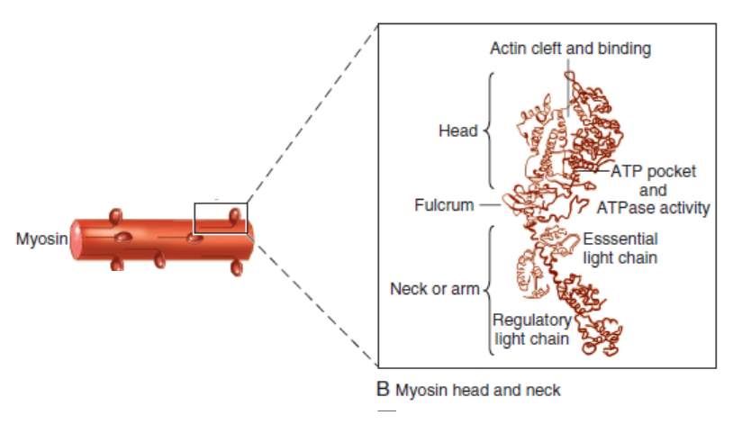
MYOSIN(Rayment)
Notes:
Myosin the thick filament is composed of a filamentous tail and a globular head region .Each myosin head is the terminal part of a heavy chain
The bodies of two of these chains intertwine and each terminates in a short“neck” that carries the elongated myosin head.This globular head contains the site for actin binding as well as a catalyzing site for ATPase activity.The molecular structure of the myosin head, based on Rayment and colleagues is composed of heavy and light chains. The heavy head chain in turn has two major domains: one of 70 kDa (i.e., 70,000 molecular weight) that interacts with actin at the actin cleft and has an ATP binding pocket. The “neck” domain of 20 kDa, also called the “lever,” is an elongated alpha helix that extends and bends and has two light chains surrounding it as a collar. The essential light chain is part of the structure. The other regulatory light chain may respond to phosphorylation to influence the extent of the actin-myosin interaction.

Slide 25
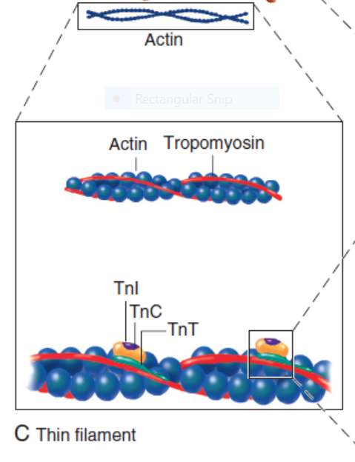
THIN FILAMENT
Notes:
The thin filaments are composed of two helical intertwining actin filaments with a long tropomyosin molecule that spans seven actin monomers located in the groove between the two actin filaments. At every seven actin molecules (38.5 nm along this structure) sits a three protein regulatory troponin complex: troponin C (Ca2+ binding), I (inhibitory), and T (tropomyosin binding

Slide 26
ACTIN
Notes:
Actin is the major contractile protein found in the thin filament
Has two forms G and F
F-actin is the backbone of the thin filament with G-actin working as a stabilizing protein
Each G-actin monomer has two myosin binding sites
The interaction between the myosin globular head and the G-actin monomer in the presence of ATP results in crossbridge formation and sarcomere shortening

Slide 27
TROPOMYOSIN
Notes:
Tropomyosin is another protein found in the thin filament.This rigid molecule lies on either side of actin adding rigidity to the thin filament.Tropomyosin influences actin-myosin crossbridge formation by physically interdigitating between the actin-myosin cleft thus preventing Ca2+ binding.When [Ca2+]i is low, the tropomyosin molecule is positioned in such a way that it blocks the myosin heads from interacting with actin. As a result, most cross bridges are in the “blocked position,” although some might visit the weak binding state

Slide 28
TROPONIN
Notes:
The troponin complex also present in the thin filament is composed of three proteins: troponin T, I, and C.Troponin regulates the extent of crossbridge formation as well as contributing to the structural integrity of the sarcomere
Troponin T binds the troponin complex to tropomyosin and anchors the complex to the thin filament
Under normal conditions phosphorylated troponin I weakens the affinity of Ca2+ for troponin C. Ca2+ binding to troponin C results in a conformational change of the complex with subsequent actin-myosin interaction thus initiating crossbridge formation.As [Ca2+]i increases and binds with troponin C, troponin C binds more tightly to troponin I. This pulls the entire troponin complex (including troponin T) away from tropomyosin (Fig. 21-4), which allows tropomyosin to roll deeper into the thin filament groove,4 thereby largely disinhibiting the actin-myosin interaction Binding of calcium to TnC induces a conformational change in TnC, which elongates (compare systole with diastole). TnI closes up to TnC, and the normal inhibition of TnI on actin-tropomyosin is lessened; however, the interaction between TnC and TnT is strengthened

Slide 29
TITIN
Notes:
Titin is a giant molecule, the largest protein yet described
It is an extraordinarily long, flexible, and slender myofibrillar protein
Titin extends from the Z-line but stops just short of the M-line connecting the thick filament to the Z-line and provides elasticity
Titin has two distinct segments: an inextensible anchoring segment and an extensible elastic segment that stretches as sarcomere length increases
So the titin molecule can stretch between 0.6 and 1.2 μm in length and has multiple functions

Slide 30
Tethers the myosin molecule to the Z-line thereby stabilizing the contractile proteins
Stretches and relaxes its elasticity contributes to the stress-strain relationship of cardiac muscle
Increased diastolic stretch of titin as the length of the sarcomere in cardiac muscle is increased causes the enfolded part of the titin molecule to straighten. This stretched molecular spring then contracts more vigorously in systole
Transduce mechanical stretch into growth signal via muscle LIM protein (MLP)
Notes:
MLP is proposed to be a stretch sensor that transmits the signals that result in the myocyte growth pattern characteristic of volume overload
This signal system may be defective in a subset of human dilated cardiomyopathy

Slide 31
Mitochondria
The maintenance of high ATP stores is a requirement of the myocyte
Mitochondria occupy 40% of myocyte cell volume emphasizing the immense energy demands of the myocyte
The typical ventricular myocyte has approximately 8000 mitochondria
Also have the capacity to bind and take up large amounts of cytosolic Ca2+ has a role in the buffering of cytosolic Ca2+ thus protecting the myocyte from the effects of Ca2+ overload

Slide 32
CROSS BRIDGE CYCLING
Notes:
The interaction of the myosin heads with actin filaments when sufficient Ca2+ arrives from the SR is called cross-bridge cycling
As the actin filaments move inward toward the center of the sarcomere they draw the Z-lines closer together so that the sarcomere shortens
The energy for this shortening is provided by the breakdown of ATP made chiefly in the mitochondria

Slide 33
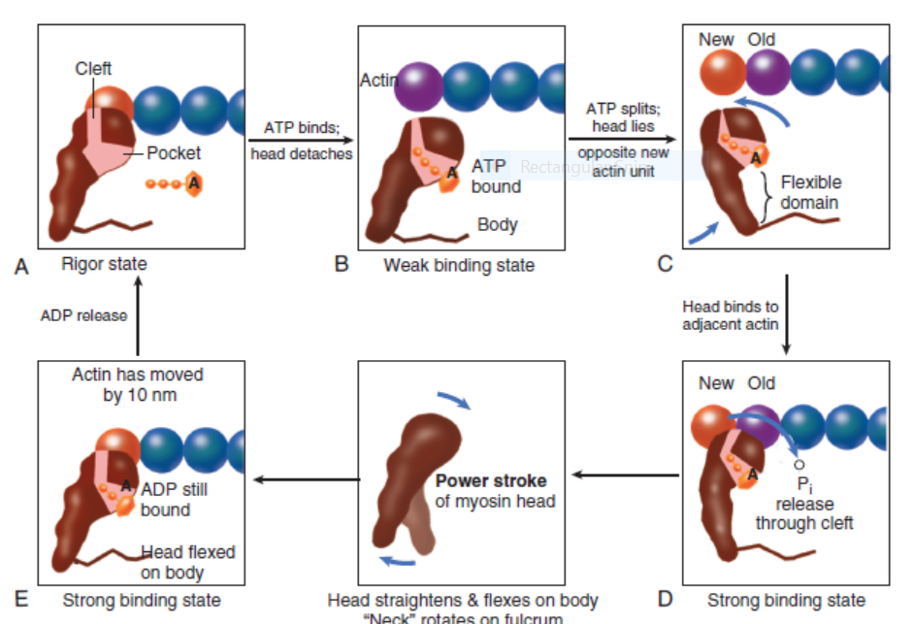
Rayment five-step model for interaction between the myosin head and the actin filament
Notes:
Cross-bridge cycling molecular model updated from the original Rayment five-step model for interaction between the myosin head and the actin filament8 that takes into account other models. The cross bridge (only one myosin head depicted) is pear shaped and consists of the catalytic motor domain, which interacts with the actin molecule, and an extended alpha helical “neck region,” which acts as a lever arm. The nucleotide pocket receiving and binding ATP is a depression near the center of the catalytic domain. The actin binding cleft bisects the catalytic motor domain. During the cross-bridge cycle, the width of the actin binding cleft changes insize, although details remain controversial. Starting with the rigor state (A), binding of ATP to the pocket (B) is followed by ATP hydrolysis (C), which partly closes the actinbinding cleft. The cleft opens when phosphate is released (through the cleft rather than through the pocket), and the myosin head strongly attaches to actin to induce the power stroke (D, E). During the power stroke the latter rotates about a fulcrum in the region where the helix terminates within the catalytic motor domain. As the head flexes, the actin filament is displaced by approximately 10 nm (E). In the process ADP is also released, so the binding pocket becomes vacant. Finally, the rigor state is reached again (A) when the myosin head is once more ready to receive ATP to reinitiate the cross-bridge cycle. Throughout, the actin monomer with which the myosin
head is interacting is speckled with dots

Slide 35
The arrival of Ca2+ at the contractile proteins is a crucial link in excitationcontraction Coupling
Binding of Ca2+ to troponin C shifts the troponin tropomyosin complex on the actin filament which permits the myosin heads to form strong binding cross bridges with actin molecules
If however, the strong binding state were continuously present the contractile proteins could never relax
Thus it has been proposed that binding of ATP to the myosin head places the cross bridges in a weak binding state even when [Ca2+]i is high
Conversely when ATP is hydrolyzed to ADP and inorganic phosphate (Pi) the strong binding state is again favored
Notes:
Hence the ATPinduced changes in the molecular configuration of the myosin head result in corresponding variations in its physical properties. Lengthdependent activation also promotes the strong binding state Conversely, the weak binding state predominates when [Ca2+]i falls
and thereby allows relaxation during diastole. As Ca2+ dissociates from troponin C during the decline in [Ca2+]i, the troponin-tropomyosin
complex resumes its inhibitory configuration to prevent strong binding.

Slide 36
Length-Dependent Activation and the Frank-Starling Effect
Otto Frank and Ernest Starling observed that the strength of the heartbeat was greater the more the diastolic filling of the heart
A part of this Frank-Starling effect has historically been ascribed to increasingly optimal overlap between the actin and myosin filaments
However, it has become clear that there is also a substantial increase in myofilament Ca2+ sensitivity with an increase in sarcomere length

Slide 37
CALCIUM ION FLUXES IN THE CARDIAC CONTRACTION-RELAXATION CYCLE
Excitation-contraction coupling
Refers to the mechanism by which an action potential leads to contraction of the myocyte
The fundamental ion for inducing the excitation-contraction coupling complex is Ca2+
Achieved through the increase in cytosolic Ca2+ levels from 100 nmol/L to 10 micromol/L concentrations

Slide 38
Contraction
As action potential reaches the myocyte the wave of depolarization particularly at the T-tubular system results in the activation of sarcolemmal voltage-sensitive L-type Ca2+ channels and Ca2+ conductance
This rapid but small influx of Ca2+ through the L-type Ca2+ channels called as trigger ca 2+ curent causes activation of the Ca2+ release channel resulting in an immediate release of large amounts of Ca2+ into the cytosol
Notes:
The Ca2+ that flows through the L-type Ca2+ channel is referred to as the trigger Ca2+ current.
The absolute amount of trigger Ca2+ is very small in relation to Ca2+ release from the sarcoplasmic reticulum; therefore, trigger Ca2+ does not significantly contribute to crossbridge formation

Slide 40
After release of Ca2+ from the sarcoplasmic reticulum a series of interactions occur within the contractile protein of the sarcomere
The sliding filament theory explain the interaction of the various contractile proteins

Slide 41
Under resting conditions concentrations of cytosolic Ca2+ are low
Phosphorylated troponin I decreases the affinity of cytosolic Ca2+ for troponin C favoring a stronger interaction between troponin I and the actin molecule
Therefore the troponin-tropomyosin complex is shifted toward the outer grooves of the actin filament thus blocking actin-myosin interaction.
An increase in cytosolic Ca2+ allows for the binding of Ca2+ to troponin C resulting in a shift of troponin I affinity from the actin filament to troponin C

Slide 42
CALCIUM FLUXES IN MYOCARDIUM
Notes:
L-type Ca2+ channels, which act as a trigger for the release of Ca2+ from the SR; (2) the effect of beta-adrenergic stimulation with adenylyl cyclase to form cAMP, the latter helping open the Ca2+ channel and increase the rate of uptake of Ca2+ into the SR; and (3) exit of Ca2+ ions chiefly via Na/Ca exchange, with the sodium pump thereafter extruding the Na+ ions thus gained.
The latter process requires ATP. Note the much higher extracellular (mM) than intracellular cytosolic [Ca2+] (<μM) and much higher [Ca2+] in the SR. Mitochondria can act as a buffer against excessive changes in the free cytosolic calcium concentration

Slide 43
SR Network and Ca2+ Movements
SR is a continuous network surrounding the myofilaments with connections across Z-lines and transversely between myofibrils This allows relatively rapid diffusion of Ca2+ within the SR to balance free [Ca2+] within the SR ([Ca2+]SR)
The total SR Ca2+ content is the sum of [Ca2+]SR plus substantially more bound to the intra-SR Ca2+ buffer calsequestrin
Ca2+]SR dictates the SR Ca2+ content, the driving force for release of Ca2+, and regulates RyR release channel gating

Slide 44
Junctional Sarcoplasmic Reticulum and Ryanodine Receptor
Notes:
The RyR channels that mediate release of Ca2+ from the SR are located at specialized junctions between the T tubule plasma membrane and the jSR membrane. Each junction has 50 to 250 RyR channels on the jSR that are directly under a cluster of 20 to 40 sarcolemmal L-type Ca2+ channels across a 15-nm junctional gap (that is actually crowded with protein). RyR2 (to denote the cardiac isoform) functions both as a Ca2+ channel and as a scaffolding protein that localizes numerous key regulatory proteins to the jSR. On the large cytosolic side, these include proteins that can stabilize RyR gating (e.g., calmodulin [CaM]; FK-506 binding protein [FKBP-12.6]); kinases that can regulate RyR gating by phosphorylation (e.g., protein kinase A [PKA] and Ca2+/ CaM-dependent protein kinase II [CaMKII]); and the protein phosphatases PP1 and PP2A, which dephosphorylate the RyR Inside the SR the RyR also couples to several proteins (e.g., junctin, triadin, and via them calsequestrin) that similarly regulate RyR gating and, in the case of calsequestrin, provides a local reservoir of buffered Ca2+ close to the release channel. The actual RyR channel is made up of a symmetric tetramer of RyR molecules, each of which may have the aforementioned regulatory proteins associated with it. Thus the RyR receptor complex is very large (>7000 kDa; Fig. 21-8).15 When the T tubule is depolarized, one or more L-type Ca2+ channels open, and local cleft [Ca2+] increases sufficiently to activate at least one local jSR RyR (multiple channels here ensure high-fidelity signaling). The Ca2+ released from these first openings recruit additional RyRs in the junction via Ca2+-induced Ca2+ release to amplify release of Ca2+ into the junctional space. The Ca2+ diffuses out of that space throughout the sarcomere to activate contraction. Each of the approximately 20,000 jSR regions in the typical ventricular myocyte seems to function independently in response to local activation by ICa. Thus the global Ca2+ transient in the myocyte at each beat is the spatiotemporal summation of SR Ca2+ release events from thousands of jSR regions, synchronized by the upstroke of the action potential and activation of ICa

Slide 45
Notes:
Role of RyR in calcium-induced calcium release. The RyR protein forms a link between the T tubule and the SR and is a scaffolding protein (which bindsother proteins such as kinases and phosphatases). This makes a macromolecular complex, also called the “foot” region. One high-affinity RyR is composed of four RyR monomer proteins. The molecular model of one RyR is schematically shown in the right panel. The four RyR proteins make a single calcium release channel, in a manner similar to the formation of some other ion channels (schematic, left panel). Depolarization stimulates the L-type Ca channel of the T tubule to allow the entry of calcium
ions. The incoming Ca binds to the RyR, which causes molecular conformational changes that result in opening of the calcium release channel and release of calcium fromthe SR

Slide 46
Turning off Ca2+ Release
Ca2+-induced Ca2+ release is a positive feedback process
I Ca2+
ICa is also inactivated by high local [Ca2+]and this robust Ca-dependent inactivation is mediated by binding of Ca2+ to the CaM that is already associated with that channel
When Ca2+ binds to CaM it alters channel conformation such that inactivation is favoured
ICa is also subject to voltage-dependent inactivation during the action potential plateau and thus inactivation limits further entry of Ca2+ into the cell

Slide 47
Ca2+-dependent RyR activation
Binding of Ca2+ to CaM that is prebound to RyR2 favors closure of the channel and inhibits reopening
Second and important is that RyR2 gating is also sensitive to luminal [Ca2+]SR such that high [Ca2+]SR favors opening and low [Ca2+]SR favors closure
Third and related factor is that as release proceeds and [Ca2+]SR declines Ca2+ flux through the RyR falls and junctional [Ca2+] also falls all of which tend to disrupt the positive feedback
That is the RyR is less sensitive to activating Ca2+ (because [Ca2+]SR is low) and [Ca2+] on the activating side is also weaker
Notes:
Release of Ca2+ from the SR during normal Ca2+ transients is robustly turned off when [Ca2+]SR falls to approximately half its normal value (≈400 µM, still 500 times higher than [Ca]i) regardless of the rate of SR Ca2+ release

Slide 48
Calmodulin
Notes:
A Versatile Mediator of Ca2+ Signaling CaM has four Ca2+ binding sites resembles troponin C, and participates in many different cellular pathways from ion channels to transcriptional regulation In many cases (in l type and ryr ) CaM is already prebound so that elevation of local [Ca2+]i can rapidly induce Ca2+-CaM effects on their targets Thus CaM signaling in myocytes is complex and is further complicated by the effects of CaMKII, which influences some of the same targets and processes as CaM itself does.Role of CaM and its kinase in regulating intracellular[Ca2+]. The rising cytosolic Ca2+ concentration in systole activates the Ca2+ regulatory system whereby Ca2+-CaM causes inactivation of L-type Ca2+ current and RyR current. This negative feedback system limits cellular Ca2+ gain. The effects of CaMKII can also modulate thesesystems.19 For example, (1) CaMKII limits the extent of Ca2+-dependent inactivation and enhances Ca2+ current amplitude, (2) it increases the fraction of SR Ca2+ released from the RyR in response to the Ca2+ current trigger (which can be arrhythmogenic), (3) it phosphorylates PLB to enhance SR Ca2+ uptake by SERCA, and (4) it can modulate Na+ and K+ channel gating in ways that are also proarrhythmic

Slide 49
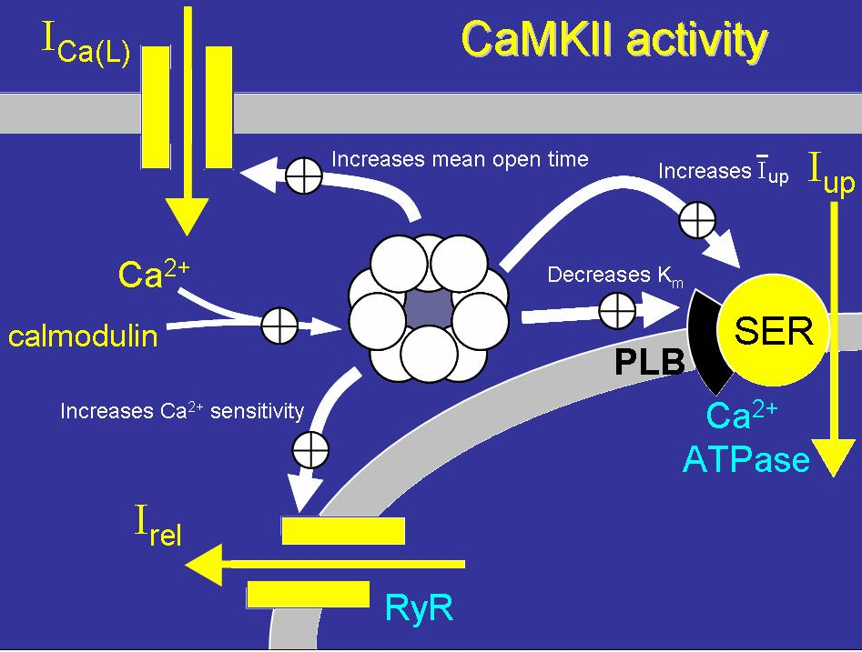
Ca2+/Calmodulin-Dependent Protein Kinase II
Alters Gating of Ina Ica and Other Channels
Notes:
CaMKII is known to be upregulated and chronically activated in numerous pathophysiologic conditions (e.g., ischemia-reperfusion, heart failure, ROSs). It has also been shown that CaMKII-dependent Na+ channel phosphorylation causes increased INaL, which may produce an acquired form of LQT3 syndrome in patients with genetically normal Na+ channels (see Fig. 21-9).19,28 At the same time, CaMKII also shifts Na+ channel availability to more negative voltages, enhances intermediate inactivation, and slows recovery from inactivation, all loss-of-function effects that could cause an acquired Brugada syndrome–like condition. Indeed, this can foster both phenotypes, depending on the heart rate: LQT syndrome at a lower heart rate and Brugada syndrome at a higher heart rate.19 CaMKII also modulates Ca2+ and K+ channel currents, and this can further promote arrhythmogenesis by enhancing the transmural dispersion of repolarization

Slide 50
Calcium Uptake into the SR by SERCA
Notes:
SERCA constitutes almost 90% of the SR protein. Several isoforms exist, but in cardiac myocytes the dominant form is SERCA2a. For each molecule of ATP hydrolyzed by this enzyme, two calcium ions are taken up and accumulate within the SR .SR Ca2+ uptake is the primary driver of cardiac myocyte relaxation, and reuptake starts as soon as [Ca2+]i begins to rise. Because Ca2+ removal is slower than Ca2+ influx and release, a characteristic rise and fall in [Ca2+]i called the Ca2+ transient takes place. As [Ca2+]i falls, Ca2+ dissociates from troponin C and this progressively switches off the myofilaments. A reduction in SERCA expression or function (as seen in heart failure or energetic limitations) can thus directly result in slower rates of cardiac relaxation. In addition, the strength of SR Ca2+ uptake directly influences the diastolic SR Ca2+ content and [Ca2+]SR, which dictates both the sensitivity of the RyR and the flux rate of SR Ca2+ release. Thus SR Ca2+ uptake and release are an integrated system. Phospholamban (PLB) was so named by its discoverers Tada and Katz to mean “phosphate receiver.” PLB binds directly to SERCA2a, and under basal conditions this reduces the affinity of SERCA for cytosolic Ca2+, which results in weaker SR Ca2+ uptake at any given [Ca2+]i. However, when PLB is phosphorylated by either PKA or CaMKII the inhibitory effect is relieved, thereby resulting in increased rates of SR Ca2+ uptake, cardiac relaxation (lusitropic effect), and increased SR Ca2+ content, which drives stronger contraction. The Ca2+ taken up into the SR is stored within the SR before further release. The highly charged low-affinity Ca2+ buffer (Kd ≈ 600 µM) calsequestrin is found primarily at the jSR and enhances the local availability of Ca for release via the nearby RyR. Calreticulin is another Ca2+-storing protein that is similar in structure to calsequestrin and probably similar in function. There is also evidence that calsequestrin and two other proteins located in the SR membrane (junctin and triadin) may regulate the properties of the RyR and be part of the mechanism by which higher [Ca]SR enhances RyR opening. Reuptake by SERCA occurs everywhere in the SR membrane in the network that surrounds the myofilaments. Diffusion of Ca2+ within the SR is relatively fast, which allows restoration of [Ca2+]SR at the jSR to occur quickly as Ca2+ is taken back up everywhere.24 Indeed, during normal Ca2+ release, intra-SR Ca2+ diffusion is rapid enough to limit Ca2+ gradients between SR release sites in the jSR and the Ca2+ uptake sites. This diffusion also ensures that [Ca2+]SR is relatively uniform throughout the myocyte, which facilitates the uniformity of SR Ca2+ release and myofilament activation throughout the cell.
Ca2+ uptake into the SR by SERCA2a. An increased rate of uptake of
Ca2+ into the SR enhances the rate of relaxation (lusitropic effect). PLB, when phosphorylated
(P), removes the inhibition exerted on the Ca2+ pump by its dephosphorylated form.
Thereby, Ca2+ uptake is increased either in response to enhanced cytosolic [Ca2+] or in
response to beta-adrenergic agonists or CaMKII activation (which can be secondary to the
beta-adrenergic system

Slide 51
SARCOLEMMAL CONTROL OF CA2+ AND NA+
Calcium and Sodium Channels
Excitation-contraction coupling is initiated by voltage-induced opening of the sarcolemmal L-type Ca2+ channels
The channels are pore-forming macromolecular proteins that span the sarcolemmal lipid bilayer to allow a highly selective pathway for transfer of ions into the heart cell when the channel changes from a closed to an open state

Slide 52
T- Versus L-Type Ca2+ Channels
Two major types of sarcolemmal Ca2+ channelsT-type and L-type channels
In adult ventricular myocytes there does not seem to be appreciable T-type ICa
T-type ICa is present in neonatal ventricular myocytes, Purkinje fibers, and some atrial cells (including pacemaker cells)
In these locations the negative activation voltages may allow T-type ICa to contribute to pacemaker function
Notes:
Even when T-type channels are expressed they do not seem to target to the regions where RyRs are and consequently they do not participate in excitation-contraction coupling
T (transient)-type channels open at a more negative voltage have short bursts of opening and do not interact with conventional Ca2+ antagonist drugs

Slide 53
L-Type Ca2+ Channel Localization and Regulation
L (long-lasting) channels are concentrated in the T tubules at jSR sites, where they are positioned for Ca2+-induced Ca2+ release from the RyR
L-type Ca2+ channels are inhibited by Ca2+ channel blockers such as verapamil, diltiazem, and the dihydropyridines
ICa is rapidly activated during the rising phase of the action potential, but the combination of Ca2+ influx via ICa itself and local SR Ca2+ release causes rapid Ca2+-dependent inactivation of Ica
Voltage-dependent inactivation also contributes to the decline in ICa during the action potential
Notes:
During beta-adrenergic stimulation, cyclic adenosine monophosphate (cAMP) and PKA activity increases and results in phosphorylation of the Ca2+ channel and alteration of its gating properties. Notably, most of the molecular components of this beta-adrenergic receptor–cAMP-PKA and phosphatase pathway are localized right at the L-type Ca2+ channel, which facilitates rapid sympathetic activation of changes in ICa. PKA-dependent phosphorylation of the channel shifts activation (and inactivation) to more negative voltages and increases the open time of the channel. This combination can greatly increase ICa, which can increase both the fraction of SR Ca2+ release and the Ca2+ load of the cell and SR (to further enhance the Ca2+ transient amplitude and inotropic state).

Slide 54
Sodium Channels
Voltage-gated cardiac Na+ current (INa) is carried mainly by the Nav1.5 cardiac isoform
Depolarization activates INa and peak INa is very large and drives the upstroke of the cardiac action potential
Voltage-dependent inactivation of INa is very rapid and under normal conditions Na+ channels inactivate within a very few milliseconds of depolarization
However a very small number of Na+ channels remain open (or reopen) thereby creating a small but persistent influx of Na+ throughout the plateau of the action potential called late sodium current (INaL
Notes:
INaL constitutes a significant inward current during the plateau phase of the action potential
Under pathophysiologic conditions the amount of INaL can increase significantly and this can result in acquired long-QT (LQT) syndrome and also cause Na+ and Ca2+ loading of myocytes which carries additional arrhythmogenic potential

Slide 55
Ion Exchangers and Pumps
Notes:
To maintain steady-state Ca2+ and Na+ balance, the amount of Ca2+ and Na+ entering during each action potential must be exactly balanced by efflux before the next beat
NCX is responsible for extruding most of the Ca2+ that entered via ICa and NCX whereas a minor fraction is extruded by the plasma membrane Ca2+-ATPase (PMCA)
NCX uses the inward [Na+] electrochemical gradient from 3 Na+ ions to pump each Ca2+ ion into the extracellular space against a large electrochemical gradient (and PMCA uses 1 ATP to pump each Ca2+ ion)
The main mechanism for extruding Na+ from the cell is Na+,K+ ATPase which pumps 3 Na+ ions out for each ATP consumed

Slide 56
Sodium Pump (Na+/K+-Adenosine Triphosphatase
Notes:
During the normal heartbeat, Na+ enters the myocyte mainly via Na+ channels and NCX with NCX being quantitatively most important
Na+ influx is matched by an equal Na+ efflux, mediated mainly via sarcolemmal Na+,K+ATPase, or the Na+ pump
The Na+ pump transports 3 Na+ ions out and 2 K+ ions in per ATP molecule used
During this process, one positive charge leaves the cell, and thus Na+,K+-ATPase is electrogenic and carries an outward current
Digitalis glycosides inhibit Na+,K+-ATPase and have been used for more than 200 years as a cardiac inotropic drug for the treatment of heart failure (although their use has diminished in recent years). Partial inhibition of Na+,K+-ATPase causes an increase in [Na+]i in myocytes, and this limits the ability of NCX to extrude Ca2+, which results in enhanced myocyte and SR Ca2+ loading and release. A limitation with this approach is that there is a narrow therapeutic range and too much inhibition can lead to myocyte Ca2+ overload and trigger arrhythmias
.

Slide 57
ADRENERGIC SIGNALING SYSTEMS
During excitement or exercise an increased number of adrenergic impulses liberate an increased amount of norepinephrine from the terminals into the synaptic cleft
Interacts with both alpha- and beta-adrenergic receptors on myocytes and also alpha-adrenergic receptors in arterioles

Slide 58
Beta-Adrenergic Receptor Subtypes
Cardiac beta-adrenergic receptors are chiefly the beta1 subtype
beta1 receptors are linked to the stimulatory G protein Gs a component of the G protein–adenylyl cyclase system
beta2 receptors are linked to both Gs and the inhibitory protein Gi
Beta1 receptors the order of agonist activity is isoproterenol > epinephrine = norepinephrine whereas in the case of beta2 receptors the orderis isoproterenol > epinephrine > norepinephrine

Slide 59
Alpha-Adrenergic Receptor Subtypes
Two types of alpha-adrenergic receptors (alpha1 and alpha2)
Those on vascular smooth muscle are vasoconstrictor alpha1 receptors whereas those situated on the terminal varicosities are alpha2-adrenergic receptors that feed back to inhibit release of norepinephrine
The relative potencies of alpha1-agonists are norepinephrine> epinephrine > isoproterenol

Slide 61
Cardiac sympathetic and parasympathetic nerves

Slide 62
Effect on the cardiac output curve of different degrees of sympathetic or parasympathetic stimulation
Notes:
The pumping effectiveness of the heart also is controlled by the sympathetic and parasympathetic (vagus) nerves, which abundantly supply the heart, as shown in Figure 9–10. For given levels of input atrial pressure, the amount of blood pumped each minute(cardiac output) often can be increased more than 100 per cent by sympathetic stimulation. By contrast, the output can be decreased to as low as zero or almost
zero by vagal (parasympathetic) stimulation.

Slide 63
G proteins
G proteins are a superfamily of proteins that bind guanine triphosphate (GTP) and other guanine nucleotides
crucial in carrying the signal onward from the agonist and its receptor to the activity of the membrane-bound enzyme system that produces the second messenger cAMP
Combination of the beta receptor, G protein complex, and adenylyl cyclase is the crux of beta-adrenergic signaling
Notes:
The activity
of adenylyl cyclase is controlled by two different G protein complexes,
namely, Gs, which stimulates, and Gi, which inhibits

Slide 64
Beta1-Adrenergic and Protein Kinase A Signaling in Ventricular Myocytes
Notes:
Catecholamine stimulation → beta receptor → molecular changes → binding of GTP to the αs subunit of G protein → GTP-αs subunit stimulating adenylyl cyclase → formation of cAMP from ATP → activation of cAMP-dependent PKA, locally bound by an AKAP → phosphorylation of the target proteins.The L-type Ca2+ channel is rapidly phosphorylated by this cascade, which results in both a large increase in the amount of peak ICa and a shift in the activation voltage to more negative potentials. This increases the amount of Ca2+ that enters the cell at each beat and also enhances excitability (especially in pacemaker cells). In addition, the higher ICa triggers more SR Ca2+ release, but the higher peak ICa and SR Ca2+ release also enhances Ca-dependent inactivation of ICa, which limits the total amount of Ca2+ entry during the action potential. This contributes to an increased Ca2+ transient amplitude, the inotropic effect, and also the chronotropic and dromotropic effects of PKA.

Slide 66
Notes:
Adenylyl cyclase is a transmembrane enzyme (also sometimes called adenylate or adenyl cyclase) thatexists in many different isoforms that respond to input from G proteins. When stimulated by Gs, adenylyl cyclase produces the second messenger cAMP, which then actsthrough a further series of intracellular signals and importantly the third messenger PKA to mediate the chronotropic, inotropic, lusitropic, and dromotropic
effects of beta-adrenergic agonists. In contrast, cholinergic stimulation exerts inhibitory influences, largely on the heart rate, but also on contraction, and acts at least in part by decreasing the rate of formation of cAMP. Another nucleotide, cyclic guanosine monophosphate (cGMP), acts as a second messenger for some aspects of vagal activity and is a second messenger involved in NO signaling

Slide 67
Nitric Oxide
NO the focus of the Nobel Prize Award for 1998 is a unique messenger in that it is formed in so many tissues is a gas and is a physiologic free radical
NO is generated in the heart by one of three isoenzymes
All three isoforms are present in the heart,including NOS1 (nNOS, or neuronal NOS), NOS2 (iNOS, inducibleNOS), and NOS3 (eNOS, or endothelial NOS)

Slide 68
Inotropic Effects
In the basal state the effect of NO is bimodal, with a positive inotropic effect at low amounts of NO exposure but a negative one at higher amounts
Lusitropic Effects
Desensitization of cardiac myofilaments was also postulated to mediate an increase in diastolic fiber length by NO
Chronotropic Effects
Intracellular increases in cGMP with exogenous and endogenous NO decrease the spontaneous beating rate

Slide 69
KEY TERMS
Contractility
Contractility or the inotropic state is the inherent capacity of the myocardium to contract independently of changes in preload or afterload
Means a greater rate of contraction to reach a greater peak force
Increased contractile function is associated with enhanced rates of relaxation or a lusitropic effect
Factors that increase contractility include exercise, adrenergic stimulation, digitalis, and other inotropic agents

Slide 70
Preload and Afterload
Preload is the load present before contraction has
Afterload is the load that the left ventricle does work against during ejection
Notes:
When preload increases, the left ventricle distends during diastole, and stroke volume rises according to Starling’s). The heart rate also increases by stimulation of atrial mechanoreceptors, which enhances the rate of discharge of the SA node. Thus cardiac output (stroke volume times
heart rate) rises.

Slide 71
Starling’s Law of the Heart
Starling in 1918 proposed that within physiologic limits the larger the volume of the heart the greater the energy of its contraction and the amount of chemical change at each contraction

Slide 72
FRANK
Frank in 1895 reported that the greater the initial LV volume the more rapid the rate of rise the greater the peak pressure reached and the faster the rate of relaxation
These complementary findings of Frank and Starling are often combined into the Frank-Starling law

Slide 73
Anrep Effect
When aortic pressure is elevated abruptly ejection is limited and EDV tends to increase which acutely increases force and pressure at the next beat via the Frank-Starling effect
However there is a slower adaptation that takes seconds to minutes whereby the inotropic state of the heart increases (and Ca2+ transients are larger)
Notes:
This slow force response or adaptation is referred to as the Anrep effect (based on von Anrep’s 1912 paper). Extensive study has implicated stretch-induced activation of several important autocrine/paracrine myocyte signaling pathways in this slowly developing inotropic effect.59 These include angiotensin II, endothelin-1, EGFRs, mitochondrial ROS production, activation of Na/H exchange,increased [Na+]i and NCX-dependent Ca2+ loading, and enhanced Ca2+ transients.

Slide 74
Wall Stress
A more exact definition of afterload is the wall stress during LV ejection
According to Laplace’s law wall stress = (pressure × radius)/(2 × wall thickness)
Notes:
FIRST the larger the LV size and radius the higher the wall stress Second, at any given radius (LV size), the greater the pressure developed by the left ventricle, the greater the wall stress An increase in wall stress achieved by either of these two mechanisms (LV size or intraventricular pressure) will increase myocardial oxygen uptake because a greater rate of ATP use is required as greater tension develops in the myofibrils

Slide 75
Treppe or Bowditch Effect
An increased heart rate progressively enhances the force of ventricular muscle contraction
Largely attributable to changes in Na+ and Ca2+ in the myocyte
At a higher heart rate there is more Na+ and Ca2+ entry per unit time and less time for the cell to extrude these ions resulting in higher [Na+]i and cellular and SR Ca2+ content

Slide 76
Work Output of the Heart
The stroke work output of the heart is the amount of energy that the heart converts to work during each heartbeat
Minute work output is the total amount of energy converted to work in 1 minute
Work output of the heart is in two forms
volume-pressure work or external work - the major proportion used to move the blood from the low-pressure veins to the high-pressure arteries
kinetic energy of blood flow component of the work output- minor proportion of the energy used to accelerate the blood to its velocity of ejection through the aortic and pulmonary valves

Slide 77
Right ventricular external work output is normally about one sixth the work output of the left ventricle because of the sixfold difference in systolic pressures that the two ventricles pump
Ordinarily the work output of the left ventricle required to create kinetic energy of blood flow is only about 1 per cent of the total work output of the ventricle
But in certain abnormal conditions,such as aortic stenosis, in which blood flows with great velocity through the stenosed valve, more than 50 per cent of the total work output may be required to create kinetic energy of blood flow

Slide 78
Graphical Analysis of Ventricular Pumping
Notes:
Figure 9–7 shows a diagram that is especially useful in explaining the pumping mechanics of the left ventricle.The most important components of the diagram are the two curves labeled “diastolic pressure” and “systolic pressure.” These curves are volume-pressure curves.The diastolic pressure curve is determined by filling the heart with progressively greater volumes of blood and then measuring the diastolic pressure immediately before ventricular contraction occurs, which is the enddiastolic pressure of the ventricle. The systolic pressure curve is determined by recording the systolic pressure achieved during ventricular contraction at each volume of filling. Until the volume of the noncontracting ventricle rises above about 150 milliliters, the “diastolic” pressure does not increase greatly. Therefore, up to this volume, blood can flow easily into the ventricle from the atrium. Above 150 milliliters, the ventricular diastolic pressure increases rapidly, partly because of fibrous tissue in the heart that will stretch no more and partly because the pericardium that surrounds the heart becomes filled nearly to its limit.
During ventricular contraction, the “systolic” pressure increases even at low ventricular volumes and reaches a maximum at a ventricular volume of 150 to 170 milliliters. Then, as the volume increases still further, the systolic pressure actually decreases under some conditions, as demonstrated by the falling systolic pressure curve in Figure 9–7, because at these great volumes, the actin and myosin filaments of the cardiac
muscle fibers are pulled apart far enough that the strength of each cardiac fiber contraction becomes less than optimal.Note especially in the figure that the maximum systolic pressure for the normal left ventricle is between 250 and 300 mm Hg, but this varies widely with each person’s heart strength and degree of heart stimulation by cardiac nerves. For the normal right ventricle, the maximum systolic pressure is between 60and
80 mm Hg.

Slide 79
The red lines in Figure form a loop called the volume-pressure diagram of the cardiac cycle for normal function of the left ventricle
It is divided into four phases
Phase I: Period of filling
Phase II: Period of isovolumic contraction
Phase III: Period of ejection
Phase IV: Period of isovolumic relaxation
The area subtended by this functional volume-pressure diagram (labeled EW) represents the net external work output of the ventricle during its contraction cycle
Notes:
Phase I: Period of filling. This phase in the volumepressure diagram begins at a ventricular volume of about 45 milliliters and a diastolic pressure near 0 mm Hg. Forty-five milliliters is the amount ofprevious heartbeat and is called the end-systolic volume. As venous blood flows into the ventricle from the left atrium, the ventricular volume normally increases to about 115 milliliters, called the end-diastolic volume, an increase of 70
milliliters. Therefore, the volume-pressure diagram during phase I extends along the line labeled “I,” with the volume increasing to 115 milliliters and the diastolic pressure rising to about 5 mm Hg.
Phase II: Period of isovolumic contraction. During isovolumic contraction, the volume of the ventricle does not change because all valves are closed.However, the pressure inside the ventricle increases to equal the pressure in the aorta, at a pressure value of about 80 mm Hg, as depicted by the arrow end of the line labeled “II.”
Phase III: Period of ejection. During ejection, the systolic pressure rises even higher because of still more contraction of the ventricle. At the same time, the volume of the ventricle decreases because the aortic valve has now opened and blood flows out of the ventricle into the aorta. Therefore, the curve labeled “III” traces the changes in volume and systolic pressure during this period of ejection.
Phase IV: Period of isovolumic relaxation. At the end of the period of ejection, the aortic valve closes, and the ventricular pressure falls back to the diastolic pressure level. The line labeled “IV” traces this decrease in intraventricular pressure without any change in volume. Thus, the ventricle returns to its starting point, with about 45 milliliters of blood left in the ventricle and at an atrial pressure near 0 mmHg.

Slide 80
Chemical Energy Required for Cardiac Contraction
Energy is derived mainly from oxidative metabolism of fatty acids
Efficiency of Cardiac Contraction.
During contraction most of the expended chemical energy is converted into heat and a much smaller portion into work Output
The ratio of work output to total chemical energy expenditure is called the efficiency of cardiac contraction, or simply efficiency of the heart
Maximum efficiency of the normal heart is between 20 and 25 %
In heart failure, this can decrease to as low as 5 to 10 per cent.
Notes:
and, to a lesser extent from other nutrients, especially lactate and glucose

Slide 81
CONCLUSION
Notes:
The ventricular myocyte is a remarkably well tuned system which can rapidly vary its output to a wide range of physiologoic stimuli by changing ion currents
Calcium handling,ion currents and myofilaments play a crucial role

Slide 82
Thank you

